Slide 1

ECHOSCAPE
Create Your Calm

Slide 2

44% of Adults have Anxiety Disorders¹
People Shut Down
Relationships Degrade
“Great Rewiring of Childhood”²
200% increase since 2003
Notes:
Graph or pie chart image
Stock image of a depressed/stressed guy

Slide 3

The Cost of Anxiety at Work
12 Bn
Working days
lost per year³
63%
Mental health sick days due to burnout⁴
$1 T+
Economic hit
annually

Slide 4

Meditation Reduces Symptoms by 30%
Reshape the brain in 8 weeks
(Harvard Medical School)⁵
Reduces Cortisol Levels

Slide 5
Only 20% of People Meditate Regularly⁶
ECHOSCAPE Proprietary Customer Research
      “My mind wanders too much”
      “Not enough time”
      “I need to move”
      “It feels like a chore”
62%
56%
46%
41%
Consistency increases when people feel calm

Slide 6
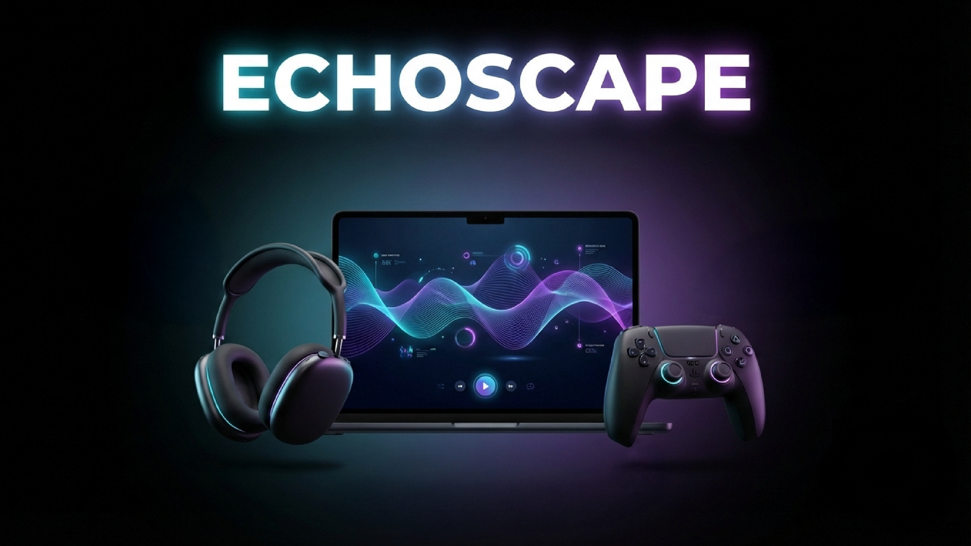

Slide 7
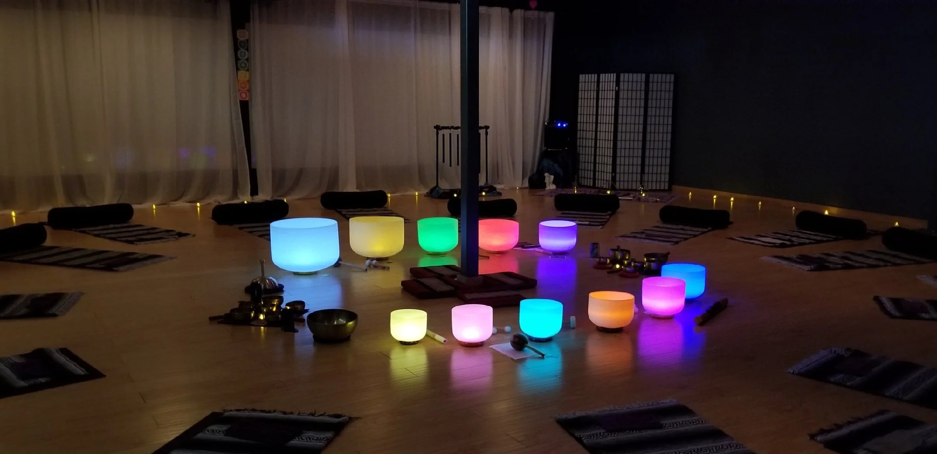
Sound Healing is Neuroscience
Sound Improves
Calmness By 65%⁷
Calmness strengthens
consistency

Slide 8
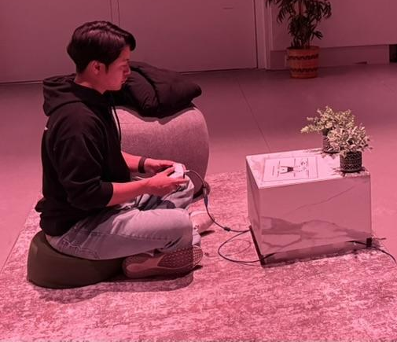
Game Controller Drives Calmness
Meditation in Motion
Reduces Anxiety Symptoms⁸
Sensory Input Reduces Stress,
Increases Concentration⁹

Slide 9
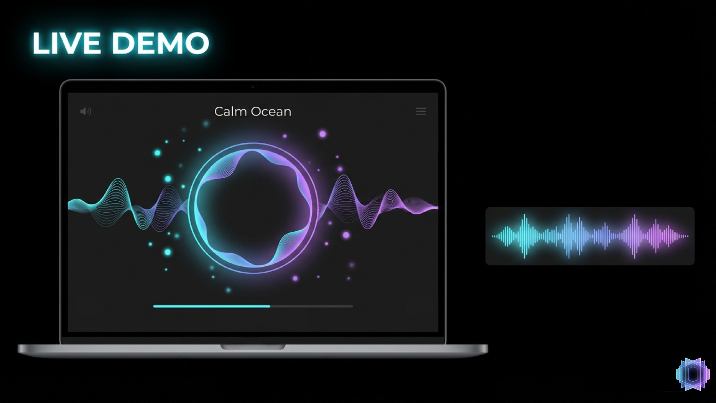

Slide 10
97% of ECHOSCAPE Users
Felt More Calm
“Calming yet stimulating!”
“Unreal”
“Fun and relaxing”
“It was very calming and intriguing”
97%

Slide 11



ECHOSCAPE
✓ | ✓ | X | ✓
✓ | X | ✓ | ✓
✓ | X | X | ✓
✓ | ✓ | ✓ | X
✓ | X | X | X
Immersive Sound Library
Controller Input
Multi-sensory
Personalized Journey
Create Your Calm

Slide 12
67 Million US Gamers Have Anxiety¹⁰
$28 Bn+
Digital Mental Health Market
$480 M+
Meditation App and Gaming
$20 M+
Age 18-35 Anxious Gamers
Notes:
68 Million Gamers Have Anxiety in the US alone. There are roughly 205 million gamers in the US alone
There are 3.2 billion gamers worldwide. When you take into account the average of 30% of the population having an anxiety disorder (whether diagnosed or not), you get ~1 billion

Slide 13



Built-in User-base of 147 Million Gamers
$15-20
$5/month
Steam Release
PC and Mac
Scale to iOS/Android
and Corporate Wellness
$5
$5 M
Quarterly Expansion Release
3 Year
Revenue
Notes:
28,000 users a month at $5/month become $140,000/month revenue, the $1.68 M/month and $5.04 M/month

Slide 14
Month 1-3
Hire Team
of Engineers
for full production
Month 4-6
Steam
Early Access
User Feeback
Year 1
Analytics
Content Updates
Year 2+3
Scale to
iOS/Android

Slide 15
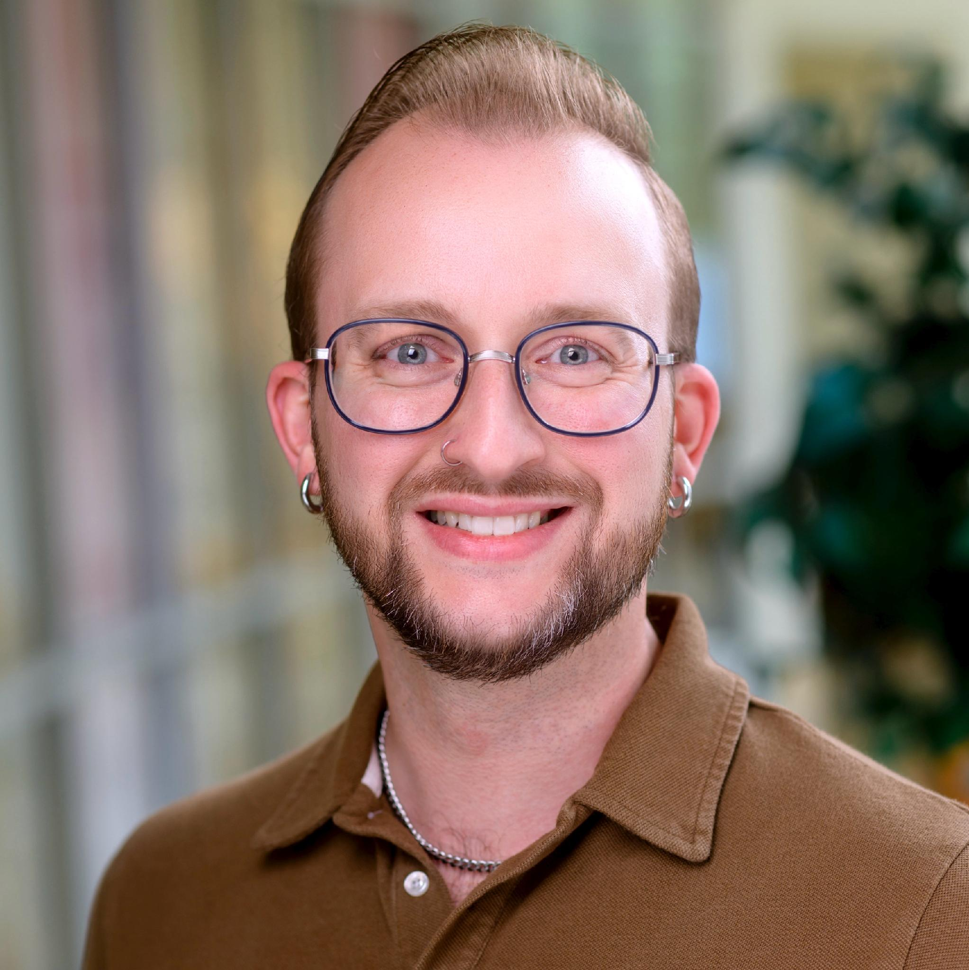


ECHOSCAPE Team
Mike Ahearn Wilcox
Founder
Greg Donovan
Advisor
Natalia Pollack
Programmer

Slide 16
Funding for Full Development
2 Engineers + 1 Designer
$250,000
Sound Libraries
Conventions and
Press Outreach

Slide 17
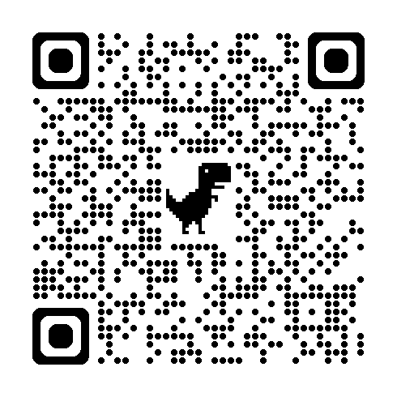
ECHOSCAPE
SCAN TO JOIN
OUR JOURNEY
Create Your Calm

Slide 18
Appendix
USER ACQUISITION TIMELINE
Month 3
1,000 users
$5K MRR
Steam Early Access and Next Fest
Month 6
5,000 users
$25K MRR
Full Steam launch
LTV (Lifetime Value): $180
CAC (Customer Acquistion Cost): $6 LTV:CAC = 30:1
Month 12
10,000 users
$50K MRR
Mobile expansion begins
Year 2
50,000 users
$5M+ ARR
B2B corporate wellness pilots
Each phase expands the addressable audience while building on proven traction. Year 1 validates. Year 2 scales. Year 3 compounds.

Slide 19


Appendix
Every $1 invested in mental health returns $4 in productivity. Employers are spending — EchoScape can capture this. (WHO / Harvard Business School)
Non-invasive. Zero side effects. The science is clear: meditation should be the first line of defense.
Sound immersion activates the parasympathetic response
Swelling soundscapes regulate heart rate variability
Vibroacoustic stimulation induces deeper relaxation than meditation alone

Slide 20
Appendix
¹ https://www.sciencedirect.com/science/article/pii/S016503272300530X
² Jonathon Haidt “The Anxious Generation”
³ https://www.paho.org/sites/default/files/2025-04/7-irarrazaval-march-25-session-2.pdf?utm
⁴ https://www.gallup.com/workplace/288539/employee-burnout-biggest-myth.aspx
⁵ https://www.health.harvard.edu/mind-and-mood/mindfulness-meditation-practice-changes-the-brain
⁶ https://pmc.ncbi.nlm.nih.gov/articles/PMC11217305/#:~:text=Changes%20in%20prevalence%20of%20meditation,(+%200.27%25;%20Table%20S3).
⁷ https://www.psychiatrist.com/news/worlds-most-relaxing-song-may-reduce-anxiety-by-65/#:~:text=A%20Scientific%20Marvel?,But%20likely%20inaccurate.
⁸ https://pmc.ncbi.nlm.nih.gov/articles/PMC10800705/
⁹ https://www.fortunebusinessinsights.com/fidget-toy-market-110591
¹⁰ https://www.sciencedirect.com/science/article/pii/S2405844023041014?utm_source=chatgpt.com

